Slide 1
The battle of the neighbourhood
By: Sandeep

Slide 2
Introduction
The cosmopolitan city of Bangalore is one of the most progressive cities in India that is blessed with a year-round balmy climate
Explore the culinary scene, and lots more through these blogs about Bangalore and know the best places to visit in the ‘Garden city of the South’. Bangalore is blessed with green spaces and a striking Victorian architecture that will entice you to book a trip and enjoy the beautiful facades of this city.
Plan an exciting vacation with your friends to have the best time of your life explore the Silicon valley of India.
Bengaluru city has always been helpful for the people, be it with IT or any industrial works.
Bangalore is blessed with green spaces and a striking Victorian architecture that will entice you to book a trip and enjoy the beautiful facades of this city.

Slide 3
This is one of the best recommended city in India because
The society is great
There are a lot of like minded people
100’s of job opportunities to work on.
Business Understanding
Bangalore is one of the most popular cities in the world and it is also known as the Silicon valley of India. So, this is the city with hundreds of opportunities .
Bengaluru is famous for its excellent cuisine ,IT field. It's food culture includes an array of international cuisines influenced by the city's immigrant history.

Slide 4
In this part I have exploered,
What are the best food options available
Which sector of technology is good
Which are some most common venues?
Target Audience
My main target audience will be the one who are new to city
The one who are planning to shift to this city
Especially non residents

Slide 5
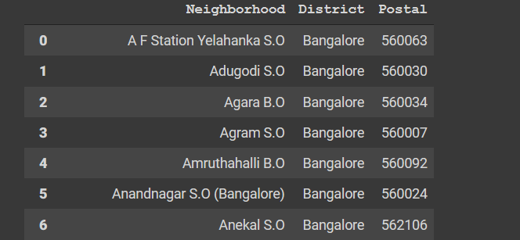
Data collection
The data collection for this was done through a website , where I get all the pincode for all the cities in India.

Slide 6
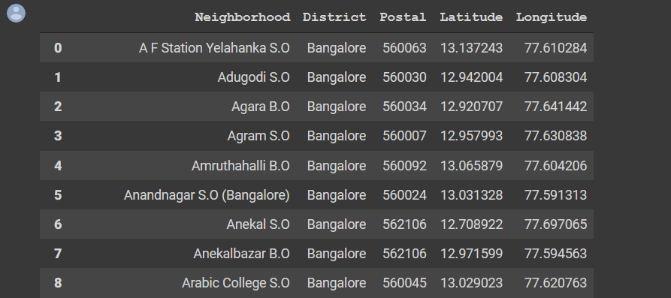
Exploratory data analysis
I have acquired the data from the sites mentioned above and filled it with latitudes and longitudes using the Geocoding API from Google Maps
To access the venues from the exact pin code address we need to use the FourSquare API. FourSquare API allows us to access the venues and most common venues based on the people’s ratings and contact numbers and a lot more

Slide 7
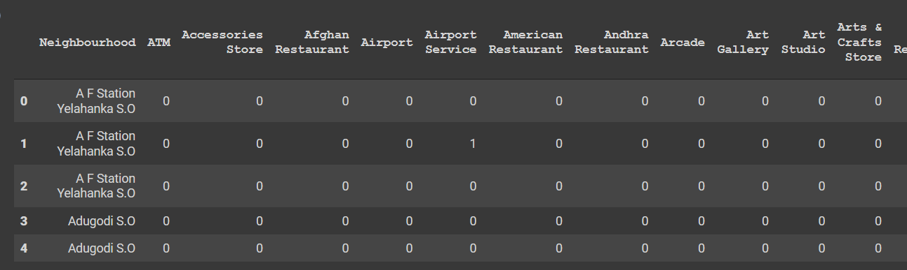
After obtaining the data set, save it in a different data frame to avoid losing the original data set.
the investigated dataset will be transformed into one-hot encoding, therefore we will convert it
The below are the datasets which are converted into one-hot encoding I.e. acquired from the explored data frame
We changed it to one-hot encoding since we need to make a prediction for where the most common venue will be for clustering the labels.
we'll use the function generated in the code to discover the places with the most common venue, and we'll obtain Bangalore.

Slide 8
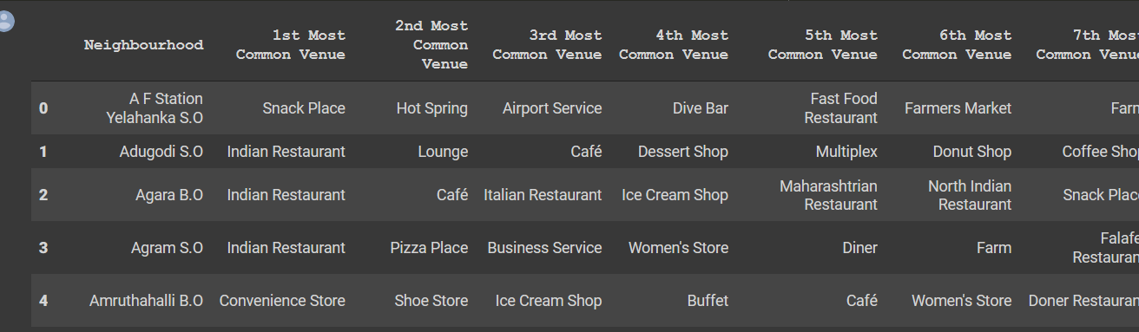
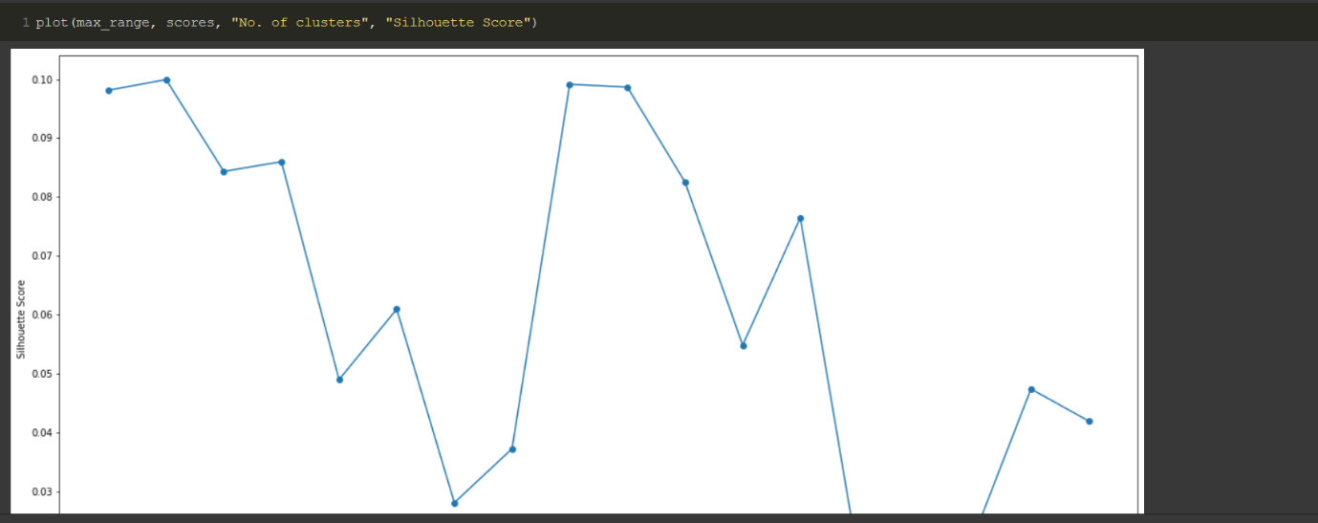
Lal
Clustering
Determine the K value for the K-mean Clustering algorithm's clustering analysis
The optimum value for the K will be 3, We'll figure it out by plotting it on a graph,

Slide 9
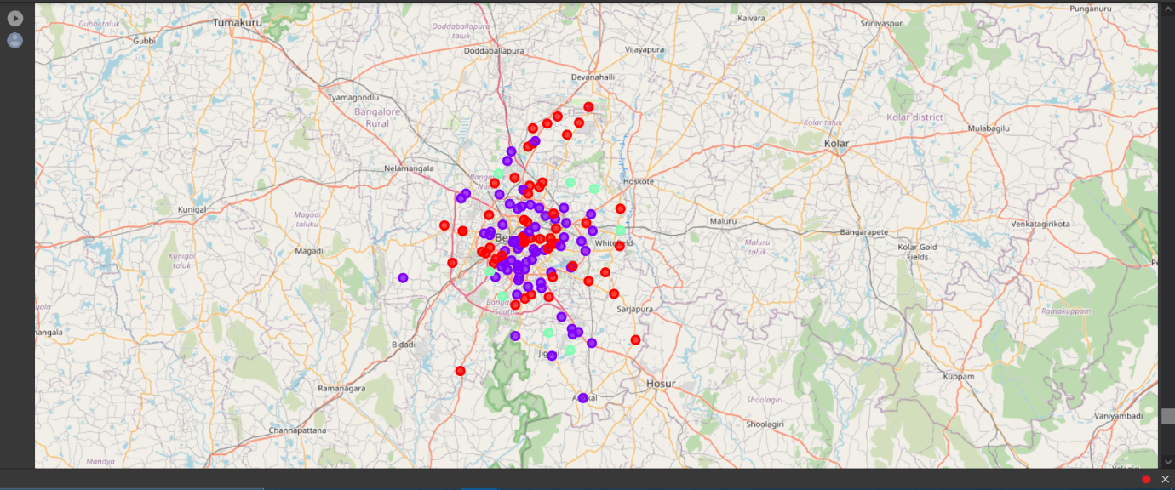
analysing with k-means clustering
Result
According to the above analysis, the best place to start to live in Bangalore are Bidrahalli, Chikkabettahalli, Doddagubi, Doddakallasandra, Hennagara, Hosakerahalli, Hulimangala and Kadugodi.

